Slide 1



Blockchain / Ethereum intro
Day 1 morning
Andrew Miller (joint slides w/ Joseph Bonneau)

Slide 2
Schedule
Day 1 Morning: Smart Contract Programming in Ethereum
- Ethereum Solidity, Remix, Pyethereum introduction
Day 1 Afternoon: (Lab time!)
- Introduce Auction assignment
- Ending talk: Security Failures in Ethereum Smart contracts
Day 2 Morning:
- Secure Smart Contracts by Example (Lotteries, State Channels)
- Research Talk: Smart contract programming models
Day 2 Afternoon:
- Developing user interfaces with javascript and the web3 API
- Using the Truffle development environment
- Research talks: Hawk and HoneyBadgerBFT

Slide 3
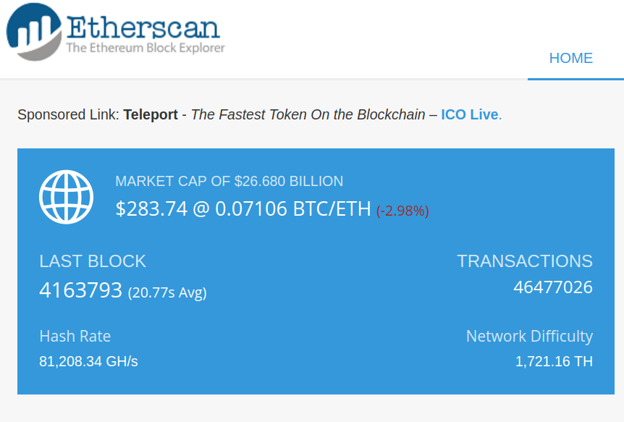
Ethereum Mainnet
Currently #2 public cryptocurrency
Several of the top cryptocurrencies are smart contracts inside Ethereum

Slide 4


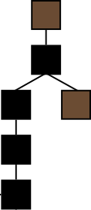
Smart Contracts: user-defined programs running on top of a blockchain
Decentralized Consensus
“Blockchain”
Money
Users
Contracts
Storage
Code
Data
Notes:
Smart contracts let us build new financial tools

Slide 5
“Smart contracts” conceptualized by Szabo in 1994
A smart contract is a computerized transaction protocol that executes the terms of a contract. The general objectives are to satisfy common contractual conditions (such as payment terms, liens, confidentiality, and even enforcement), minimize exceptions both malicious and accidental, and minimize the need for trusted intermediaries. Related economic goals include lowering fraud loss, arbitrations and enforcement costs, and other transaction costs.
-Nick Szabo “The Idea of Smart Contracts”

Slide 6


A “dumb contract” example: pay for a hash pre-image
Alice will reveal to Bob a value x such that SHA-256(x) = 0x2a...
In exchange, Bob will pay US$10.
If Alice does not reveal by July 1, 2017, then she will pay a penalty of US$1 per day that she is late, up to US$100.
Signed:

Slide 7
Traditional contracts vs. smart contracts
 | Traditional | Smart
specification | Natural language + “legalese” | Code
identity & consent | Signatures | Digital signatures
dispute resolution | Judges, arbitrators | Decentralized platform
nullification | By judges | ????
payment | As specified | built-in
escrow | Trusted third party | built-in

Slide 8
Smart Contracts: user-defined programs running on top of a blockchain
Decentralized Consensus
“Blockchain”
Money
Users
Contracts
Storage
Code
Data
Notes:
Smart contracts let us build new financial tools

Slide 9
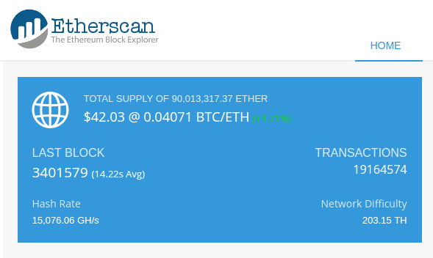
Ethereum Mainnet
Currently #2 public cryptocurrency
The #7 cryptocurrency is a smart contract inside Ethereum

Slide 10
Replicated State Machines

Slide 11
Recap: Bitcoin itself implicitly defines state
new addition | purpose | in Bitcoin
Global state | Track app-specific data | UTXO set
Opcodes | Express updates to global state | transactions
Gas | Limit computation & reads/writes to global state | not required
This state is implicit
Bitcoin scripts only succeed/fail. No side effects on global state
Miners can produce blocks which are very costly to verify

Slide 12
Replicated state machines are the classic abstraction
Set of possible states S
Set of possible inputs I
Set of possible outputs O
Transition function f: S × I → S × O
Start state s ∈ S (genesis block)

Slide 13
“Blockchain” is an ordered list of inputs w/consensus
consensus info | input
∅ | ∅
consensus info | input
nonce=0x456... | A→B 17 signed(Alice)
consensus info | input
nonce=0x123... | B→C 11 signed(Bob)

Slide 14
“State” is really just a compression of history
1
Inputs: Ø
Outputs: 25→Alice
time
Efficient: track UTXO set
{1[0]: 25, A}
2
Inputs: 1[0]
Outputs: 17→Bob, 8→Alice
SIGNED(Alice)
{2[0]: 17, B; 2[1]: 8, A}
Inefficient: Scan blockchain to check for validity
3
Inputs: 2[0]
Outputs: 8→Carol, 7→Bob
SIGNED(Bob)
{2[1]: 8, A; 3[0]: 8, C, 3[1]: 7,B}
4
Inputs: 2[1]
Outputs: 6→David, 2→Alice
SIGNED(Alice)
is this valid?

Slide 15
Blockchains may include explicit state commitments
consensus info | input | state commitment
∅ | ∅ | s = {A: 50}
consensus info | input | state commitment
nonce=0x456... | A→B 17 signed(Alice) | {A: 33, B:17}
consensus info | input | state commitment
nonce=0x123... | B→C 11 signed(Bob) | {A: 33, B:6, C: 11}

Slide 16
Explicit state commitments offer many advantages
consensus info | input | state commitment
nonce=0x123... | B→C 11 signed(Bob) | {A: 33, B:6, C: 11}
Inconsistencies surface immediately
Light clients can quickly get current state
Can efficiently verify sequence between any two blocks

Slide 17
Ethereum: A universal RSM

Slide 18
To get Turing-completeness:
Set of possible states S
Set of possible inputs I
Set of possible outputs O
Transition function f: S × I → S × O
Start state s ∈ S (genesis block)
Include arbitrary programs
Interpret programs

Slide 19

Universality brings on classic OS problems
What state can a tx change?
memory protection
How many resources can a contract use?
resource contention

Slide 20
Ethereum in one slide
States S = a map from addresses to state
Inputs I (transactions)
Transition f:
validate signature
run to.code(from, data, value, startgas, gasprice)
Start state: ∅
address | code | storage | balance | nonce
from | sig, n | to | data | value | startgas | gasprice
may affect the state of any address

Slide 21
The full* Ethereum blockchain structure
prev
height
time
nonce
difficulty
miner
extra
state root
transaction root
receipt root
address | code | storage | balance | nonce

Slide 22
The full* Ethereum blockchain structure
prev
height
time
nonce
difficulty
miner
extra
state root
transaction root
receipt root
from | sig, n | to | data | value | startgas | gasprice

Slide 23
The full* Ethereum blockchain structure
prev
height
time
nonce
difficulty
miner
extra
state root
transaction root
receipt root
final state | gas used | log output | log bloom

Slide 24
Ethereum addresses can be accounts or contracts
address | code | storage | balance | nonce
 | account | contract
address | H(pub_key) | H(creator, nonce)
code | ∅ | EVM code
storage | ∅ | Merkle storage root
balance | ETH balance
nonce | #transaction sent
Note: no UTXOs in Ethereum
Volatile fields

Slide 25
Three* types of transaction in Ethereum
type | from | sig, n | to | data | value | startgas | gasprice
create | creator | sig, n | ∅ | code | start_bal | 53000 | ?

Slide 26
Three* types of transaction in Ethereum
type | from | sig, n | to | data | value | startgas | gasprice
create | creator | sig, n | ∅ | code | start_bal | 53000 | ?
send | sender | sig, n | receiver | ∅ | transfer_val | 30000 | ?

Slide 27
Three* types of transaction in Ethereum
type | from | sig, n | to | data | value | startgas | gasprice
create | creator | sig, n | ∅ | code | start_bal | 53000 | ?
send | sender | sig, n | receiver | ∅ | transfer_val | 30000 | ?
call | caller | sig, n | contract | f, args | transfer_val | ? | ?

Slide 28
Example:
NameCoin in Ethereum

Slide 29
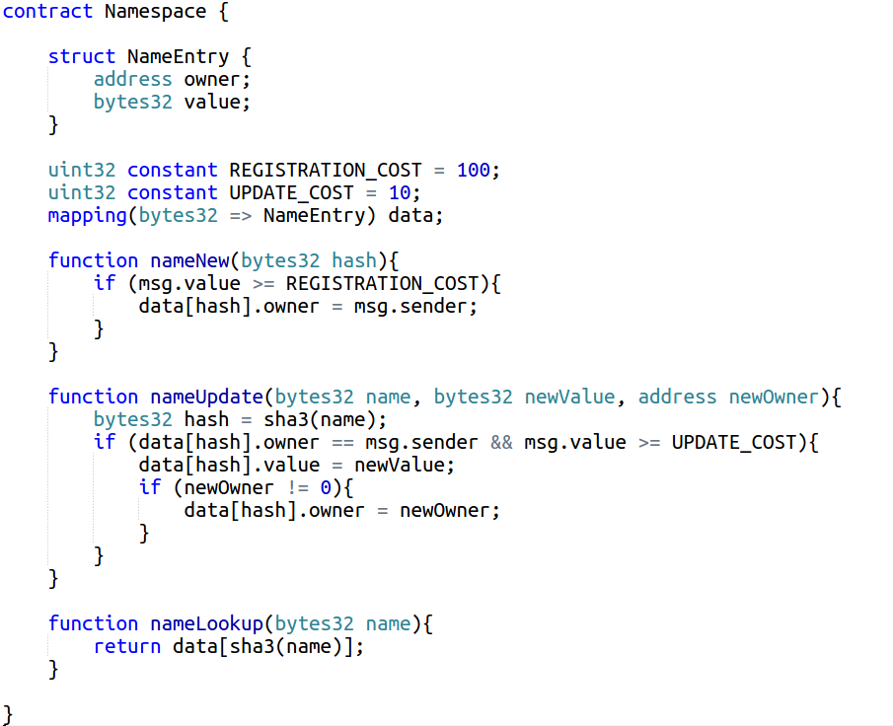

Slide 30
Ethereum
Virtual
Machine

Slide 31
EVM is stack-based, like BTC script
PUSH1 0
CALLDATALOAD
SLOAD
NOT
PUSH1 9
JUMPI
STOP
JUMPDEST
PUSH1 32
CALLDATALOAD
PUSH1 0
CALLDATALOAD
SSTORE
Features
1024-depth stack
32-byte words
Accelerated crypto
SHA-3
Big num multiply
GF-256 operations

Slide 32
EVM memory model offers a lot of space
Storage: {0,1}²⁵⁶→{0,1}²⁵⁶ map (persistent)
Memory: {0,1}²⁵⁶→{0,1}²⁵⁶ map (volatile between tx)
in other words, both can represent 2²⁶⁴ bits!
arranged in 256-bit words
all memory is zero-initialized
Storage in Ethereum is very expensive. Limiting memory use is critical

Slide 33
EVM provides basic API for I/O
Input:
tx info: sender, value, gas limit
resource use: gas remaining, memory used
block info: depth, timestamp, miner, hash
Output:
send messages (call other contracts and/or send money)
write to logs
self destruct

Slide 34
Three levels of contract call in Ethereum
Original message:
from | sig, n | to | data | value | startgas | gasprice
A | sig | B | d | x | S | g
Results of a call to C:
 | CALL | CALLCODE | DELEGATE CALL
msg.sender | A |  | B
value | x’≤ B.balance
data | (as specified)
startgas | s’ ≤ gas remaining
storage updated | C | B

Slide 35

Subtleties to contract calls
Data: unlimited params/return values
Direct mapped to memory address + size
Exceptions: out of gas, bad jump, etc.
No state changes persisted
Control returns to caller
Call stack limit: 1024
Calls from 1024th frame will fail

Slide 36
Efficient map commitments

Slide 37
How can Ethereum commit to so much state?
Recall: storage is a {0,1}²⁵⁶→{0,1}²⁵⁶ map
Requirements:
2^{n} keys supported
k keys with a non-zero value
O(1) commitment size
O(lg k) update cost
O(lg k) proofs (even for zero values)
Key insight:
Optimize for efficient storage of zeroized values

Slide 38
Non-solution: use a binary tree, paths encode address
001 | Alice
100 | Bob
110 | Carol
111 | David
0
0
1
Alice
0
0
1
1
0
Bob
1
0
1
1
0
Carol
Problem:
Requires O(2^{n}) computation
1
David

Slide 39
Optimization #1: pre-compute all sizes of empty tree
001 | Alice
100 | Bob
110 | Carol
111 | David
0
Empty[1]
0
1
Alice
0
1
Empty[2]
0
Bob
1
0
1
Empty[1]
1
0
Carol
This almost works!
Proofs are length O(lg n)
1
David

Slide 40
Optimization #2: shrink all single subtrees; store prefix
001 | Alice
100 | Bob
110 | Carol
111 | David
“kv node”
“01”, Alice
0
“diverge node”
“0”, Bob
1
0
1
0
“”, Carol
This works!
Proofs are length O(lg k)
1
“”, David

Slide 41
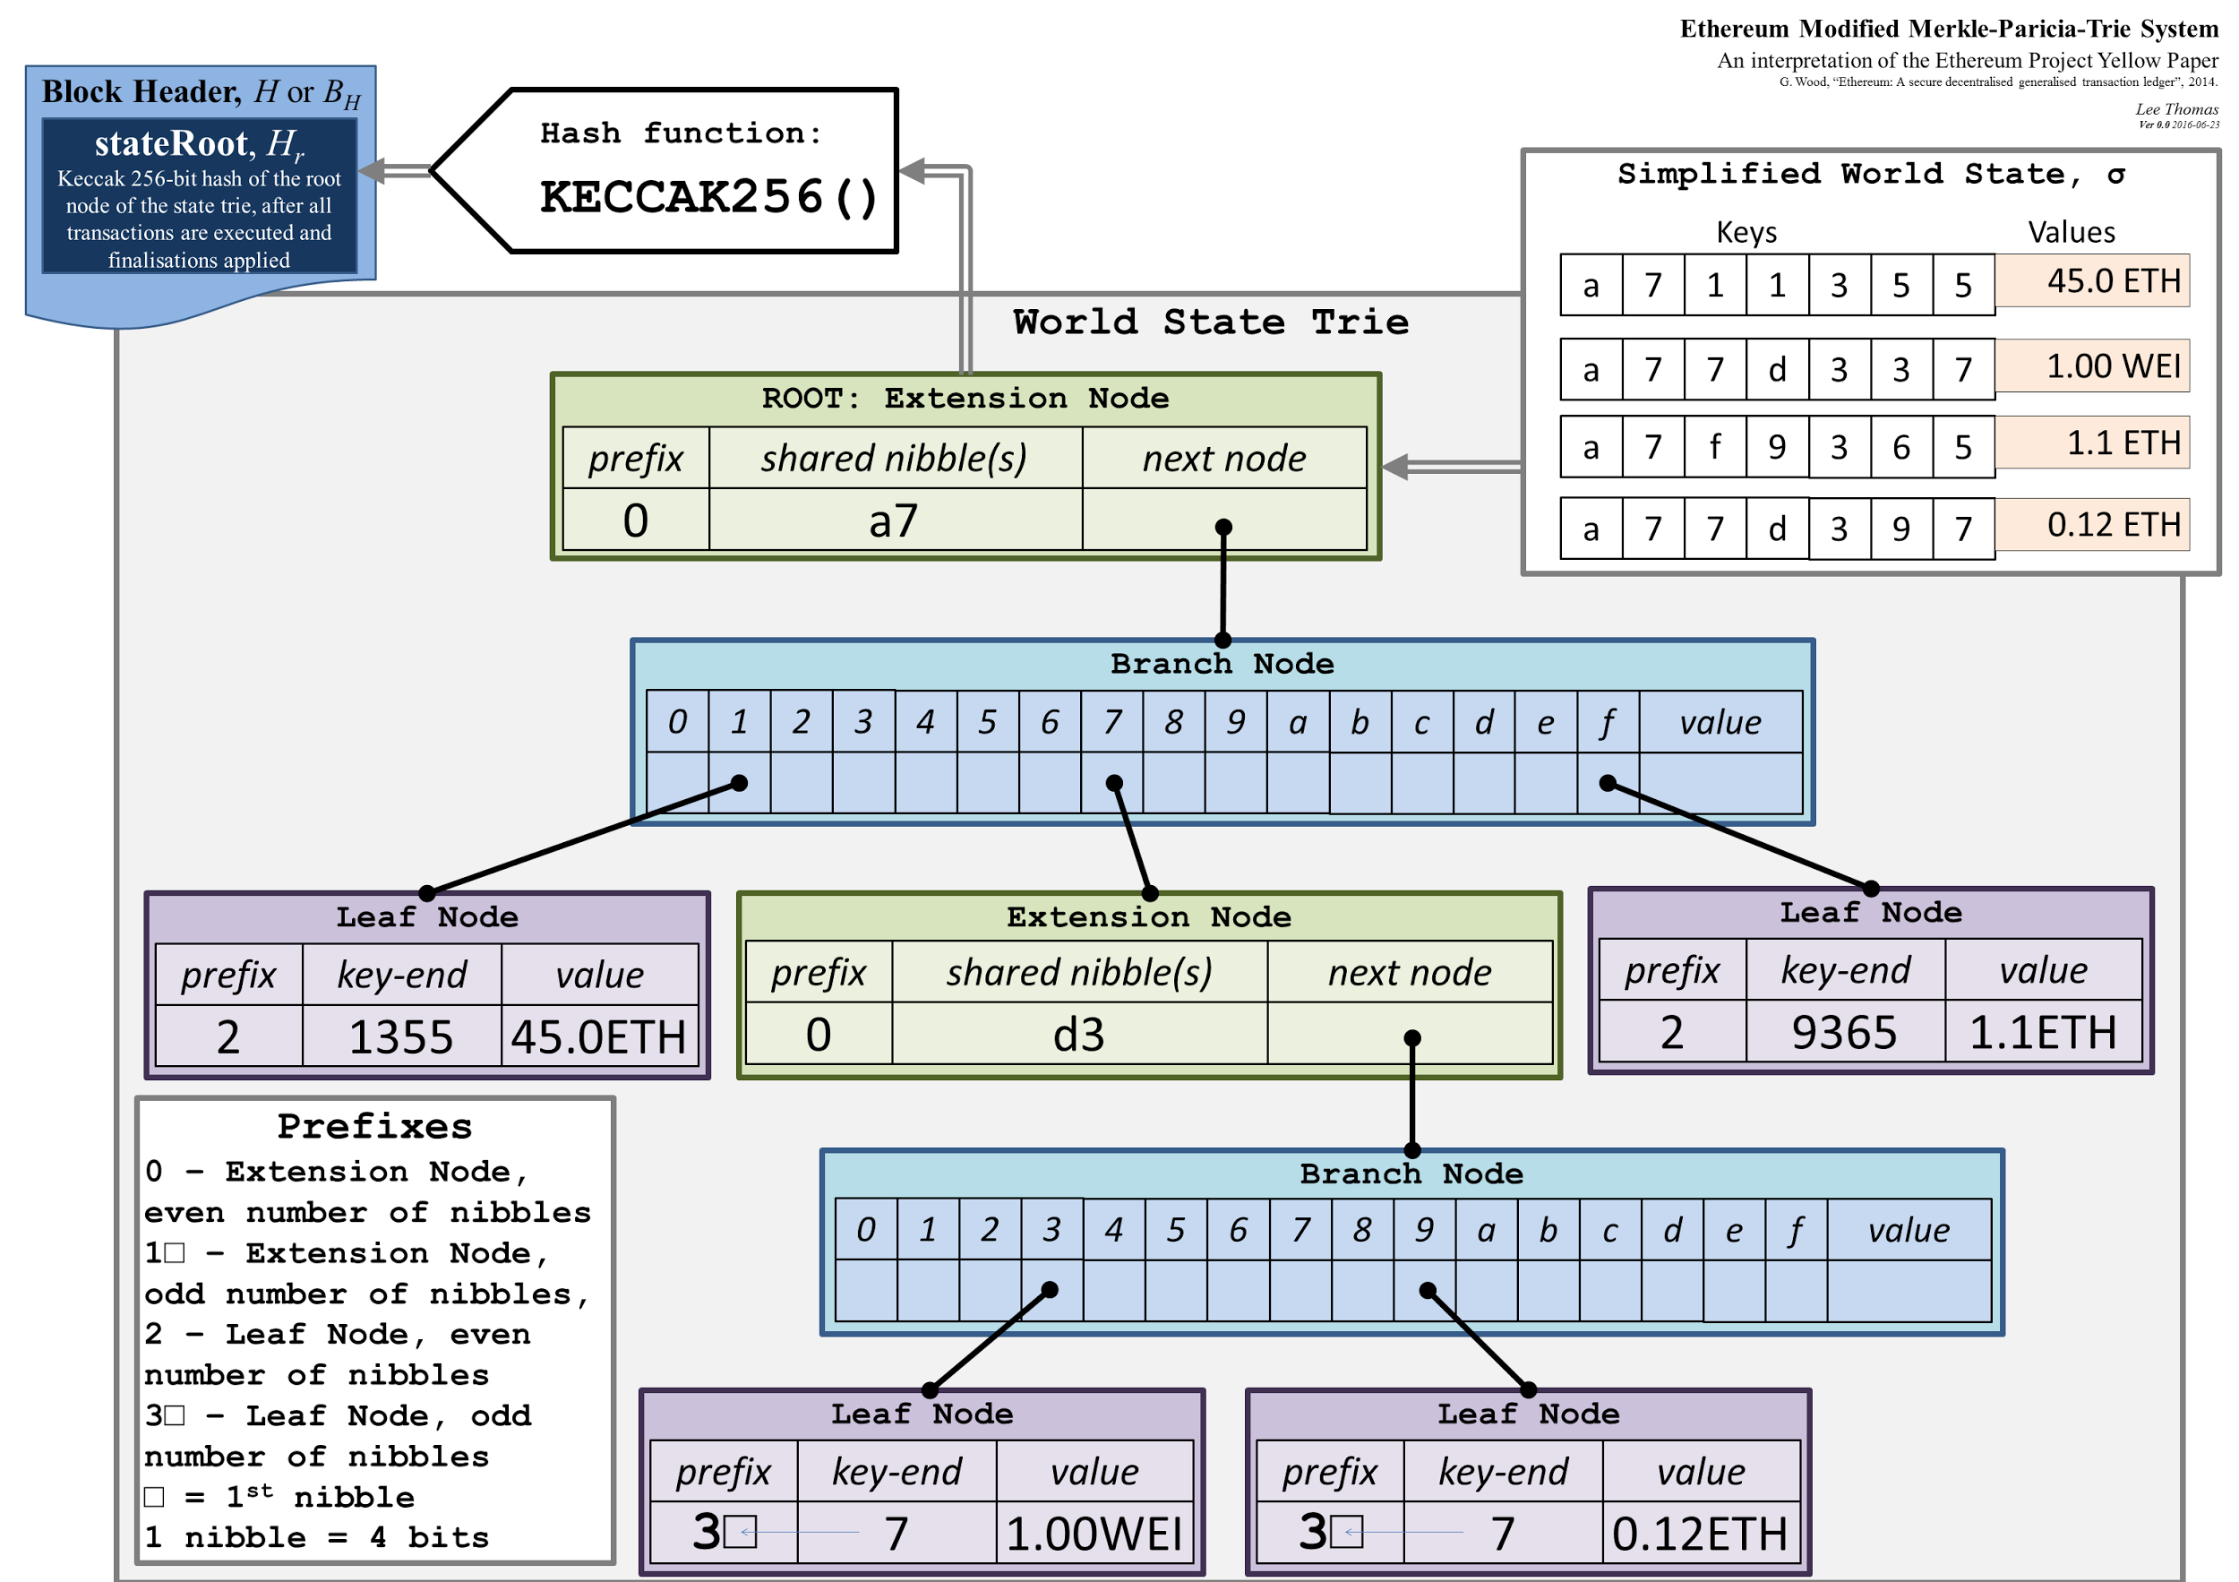
Ethereum’s “Merkle PATRICIA tree” has a few quirks
Used in two main places
overall state
per-contract storage
16-ary
proofs 4x longer
paths can be < 256 bits
“1”, “01” are distinct
Really 2²⁵⁷-1 addresses

Slide 42
Gas and transaction limits

Slide 43
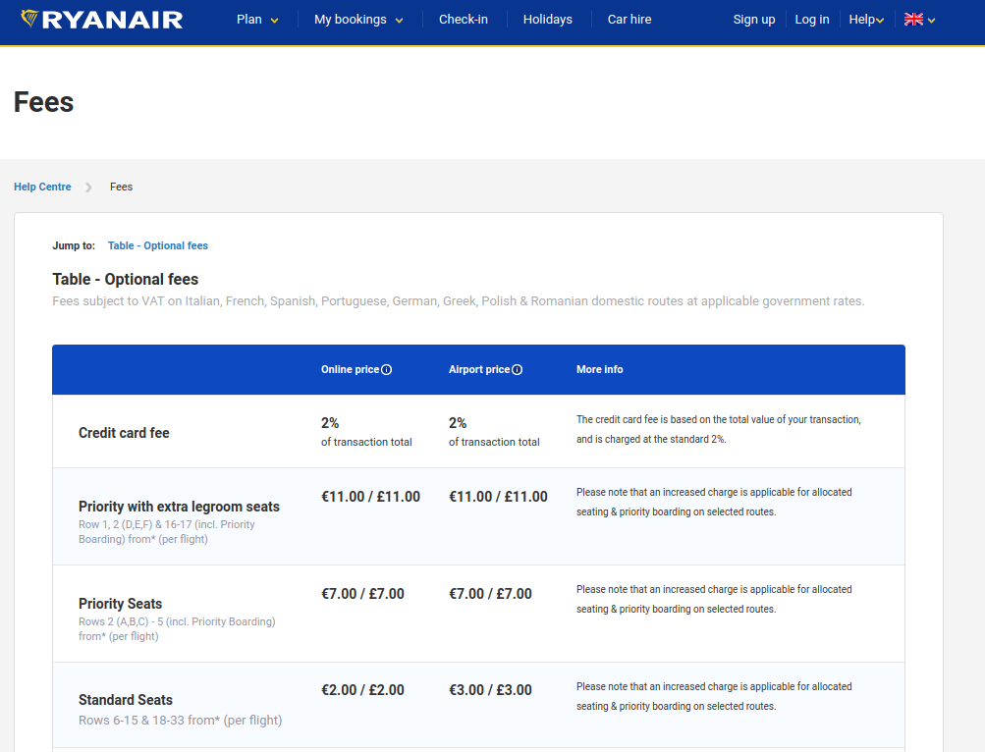
“Ethereum is Ryanair”: pay to board, then keep paying

Slide 44
Gas in Ethereum is a necessary evil
All miners must evaluate all transactions
limit computation cost
All miners must store all state
limit storage use
Short-cut the halting problem
There is an upper GAS_LIMIT, so all programs will halt

Slide 45
Every operation has a fixed gas cost
 | opcodes | gas cost
Basic operations | ADD, MUL, PUSH, JUMP | 2-10
Storage read | SLOAD | 200
Storage write | SSTORE | 5000
Storage write (from zero) | SSTORE | 20000
Storage zeroize | SSTORE | -10000
Contract call | CALL, CODECALL, etc. | 700
Transaction overhead | n/a | 21000
Contract creation | n/a | 32000
Contract destruction | SELFDESTRUCT | -19000

Slide 46
All transactions specify START_GAS, GAS_PRICE
If START_GAS ⨉ GAS_PRICE > caller.balance, halt
Deduct START_GAS ⨉ GAS_PRICE from caller.balance
Set GAS = START_GAS
Run code, deducting from GAS
For negative values, add to GAS_REFUND
GAS only decreases
After termination, add GAS + GAS_REFUND to caller.balance

Slide 47

Out-of-gas exceptions are bad news
State reverts to previous value
Except that START_GAS * GAS_PRICE is still deducted

Slide 48
Callers can choose how much gas to send
A:
function a():
assert(msg.gas == 100);
x = B.b.gas(10)()
return x + “ World!”
B:
function b():
assert msg.gas == 10
y = C.c.gas(5)()
assert(y == 0);
// out of gas
return “Hello”
C:
function c():
assert(msg.gas == 5);
while (true) {
Loop
}
return “Bonjour”
100
10
5
“Hello World!”
Out of gas
“Hello”

Slide 49
Back of envelope numbers you should know
Cost of gas (as of July ‘17): https://etherscan.io/charts/gasprice
http://ethgasstation.info/
~20gigawei = 0.00000002
Price of Ether (as of March ‘17):
~$300 per Ether
Cost per transaction:
21000 gas “base” for a transaction = $0.15 (15 cents per transaction)
Cost of data:
~75 gas per byte of data stored = $0.57/kB (57 cents per kilobyte)
Gas limit per block: 4,000,000 ⇒ 53 kilobytes per block (2.66MB per 10 min)

Slide 50
Gas today is typically 2⨉10⁻⁸ ether = 6⨉10⁻⁶ USD
 | opcodes | gas cost | USD cost [Jun ‘17]
Basic operations | ADD, MUL, PUSH, JUMP | 2-10 | ~10⁻⁴
Storage read | SLOAD | 200 | 0.004
Storage write | SSTORE | 5000 | 0.09
Storage write (from zero) | SSTORE | 20000 | 0.37
Storage zeroize | SSTORE | -10000 | -0.18
Contract call | CALL, CODECALL, etc. | 700 | 0.013
Transaction overhead | n/a | 21000 | 0.38
Contract creation | n/a | 32000 | 0.57
Contract destruction | SELFDESTRUCT | -19000 | -0.34

Slide 51
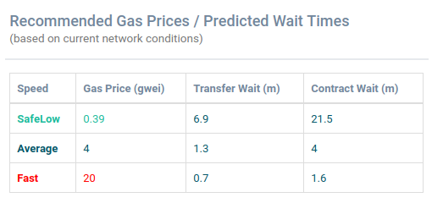
http://ethgasstation.info/

Slide 52
Economics of gas are similar to transaction fees
Miners choose transactions based on GAS_PRICE
In theory, they should not care which opcodes are used
In practice, some “overpriced” opcodes may be preferred
Maximum gas limit per block
Miners can slowly raise it, each block votes

Slide 53
Solidity

Slide 54
Ethereum Languages
Looks like python
Types, invariants, looks like Javascript
Serpent
Solidity
Viper
(Upcoming)
Functional, macros,
looks like scheme
Lower-Level Language
Ethereum VM Bytecode
Stack Language
Looks like Forth.
Defined in Yellowpaper

Slide 55
Solidity should look familiar
Syntax looks like JavaScript
Contracts look like classes/objects
Can mark functions internal
Static typing
Most types can be cast e.g. bool(x)

Slide 56
Solidity types
bool, uint8, uint16, ... uint256, int8, ... int256
address
string
byte[]
mapping(keyType ==> valueType)

Slide 57
Clever implementation of maps in Solidity
Alice | 15
Bob | 15
Joe | 100
mapping(string => uint256) balances;
15
100
15
0
2²⁵⁶
H(“balances”|”Bob”)
H(“balances”|”Joe”)
H(“balances”|”Alice”)
every item requires at least one 256-bit word
balances[“Andrew”] is 0 if “Andrew” doesn’t exist or if “Andrew” has 0 balance
to delete a key, set balances[“Andrew’] = 0
Cannot delete an entire map!

Slide 58
Polite contracts call throw on errors
uint8 numCandidates;
uint32 votingFee;
mapping(address => bool) hasVoted;
mapping(uint8 => uint32) numVotes;
/// Cast a vote for a designated candidate
function castVote(uint8 candidate) {
if (msg.value < votingFee)
return;
if (hasVoted[msg.sender])
throw;
hasVoted[msg.sender] = true;
numVotes[candidate] += 1;
}
Throw ensures no effects persisted except gas consumption

Slide 59
Modifiers ease repetitive safety checks
address public owner;
uint public electionEnd;
modifier onlyBy(address _account){
require(msg.sender == _account);
_;
}
modifier onlyAfter(uint _block) {
require(block.blocknumber >= _block);
_;
}
function endElection()
onlyBy(owner) onlyAfter(electionEnd){

Slide 60
Built-in support for calling other contracts
a.send(x) sends x to address a
returns 0 if this fails due to call stack
foo.call.value(3).gas(20764)( bytes4(sha3("bar()")));
also callcode, delegatecall
default is 0 value, all available gas
new constructor deploys a new contract
Careful, it’s expensive!
Remember:
Smart contracts code is fixed forever.
Calls required to update functionality
- Contract member variables if public, automatically defines a “getter”
- Modifiers payable, constant, returns(), also modifiers can be user defined
- Macros / Internal Functions internal modifier -> does not require a “message”
- Type conversions int(x), uint256(x), bool(x)
- Structs, arrays, mappings, memory vs storage
array: int[2] x; hashmap mapping ( int[2] => int );
- Throwing exceptions throw; // exceptions contain no data
- Units (currency: “eth”, “wei”, etc.) 3 * (2 eth)

Slide 61
Solidity gotchas (many more tomorrow)
Member variables public by default
Setters, getters automatically provided
Functions must be marked payable to accept funds
Member variables go to storage by default
Method variables go to memory
Fallback function()
Called if no function specified (e.g. send)
Called if non-existent function called
msg.sender vs. tx.origin
https://solidity.readthedocs.io/en/develop/solidity-in-depth.html

Slide 62
Key challenges in smart contract design:
- Smart Contracts in Ethereum can be trusted for correctness and availability, but not privacy
- Blockchain resources are expensive
- Race conditions and temporary forks
- Obscure and counterintuitive VM rules

Slide 63
Don’t like Solidity? Write your own language!
Looks like a Shakespearean sonnet
Untyped, looks like python
Typed, looks like JS
Typed, looks like Go
Serpent
Solidity
Mutan
Your PhD here
Lower-Level Language
Ethereum VM Bytecode
Stack Language
Looks like Forth.
Defined in Yellowpaper

Slide 64
Ethereum project

Slide 65


Ethereum is “run” by the Ethereum Foundation
Zug,Switzerland

Slide 66
Ethereum blockchain is much different than Bitcoin
Block time: 12.5 seconds
Proof-of-work: Equihash (designed to be memory-hard)
Uses a variant of GHOST protocol to reward orphan stale blocks

Slide 67
Hard Forks are planned in Ethereum
release | date
Frontier | July 2015
Homestead | March 2016
DAO hard fork | July 2016
Metropolis | 2018?
Serenity | ??

Slide 68
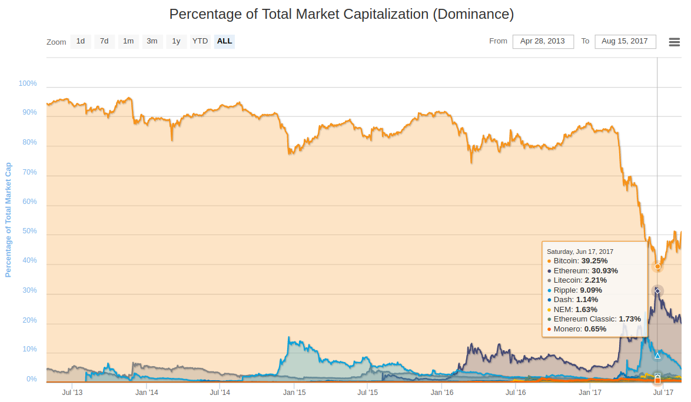
Ethereum may overtake Bitcoin in market cap
Source: coinmarketcap

Slide 69
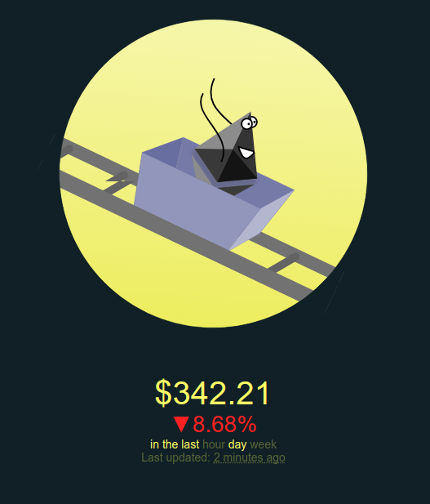
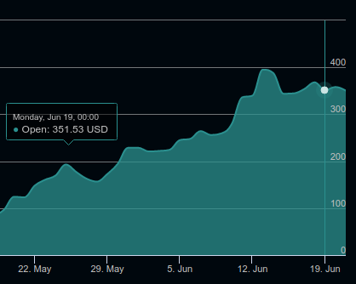
Price has been a wild ride recently
https://ethereumprice.org/
http://eth.rollercoaster.one/

Slide 70

Solidity and EVM may outgrow Ethereum itself
- Enterprise Ethereum Alliance, still in infancy (Announced Feb 28)
-Goal: support EVM, Solidity and tools for private blockchains
- maintain compatibility with Ethereum network

Slide 71
Research challenges

Slide 72

Ethereum makes all data public
Proposals:
Project Alchemy-exchange Eth for Zcash
SNARKs for token-issuing contracts
Acceleration within EVM?
Hawk: The blockchain model of cryptography and privacy-preserving smart contracts [Khosba et al. 2016]

Slide 73
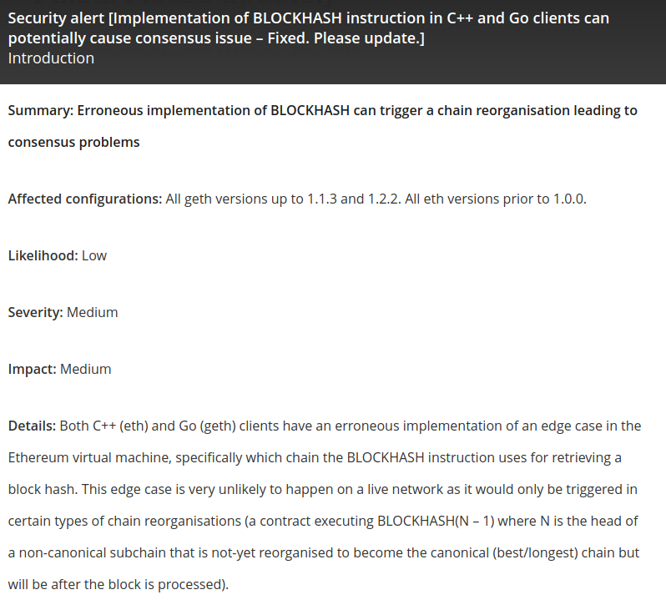
Verifying consistency of Ethereum implementations
at least 7 EVM implementations
C++, Go, Haskell, Java, Python, Ruby, Rust
Inconsistency can be exploited to cause a hard fork!

Slide 74
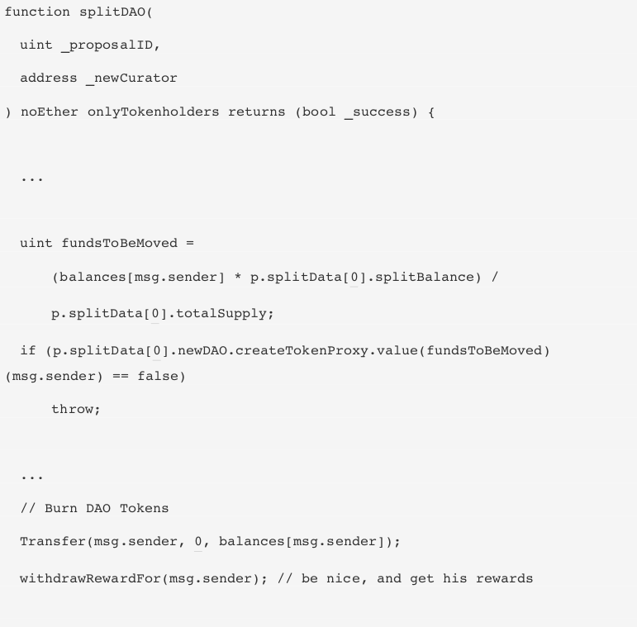
Verifying correctness of Ethereum contracts
Can you spot the bug?

Slide 75

Ethereum scaling limited as nodes verify all contracts
Can’t always determine which state a tx will change
Goal is to support sharding
Most nodes track only a random subset of contracts
Super nodes process cross-shard communication
Details get complicated... great research topic!
https://github.com/ethereum/wiki/wiki/Sharding-FAQ

Slide 76
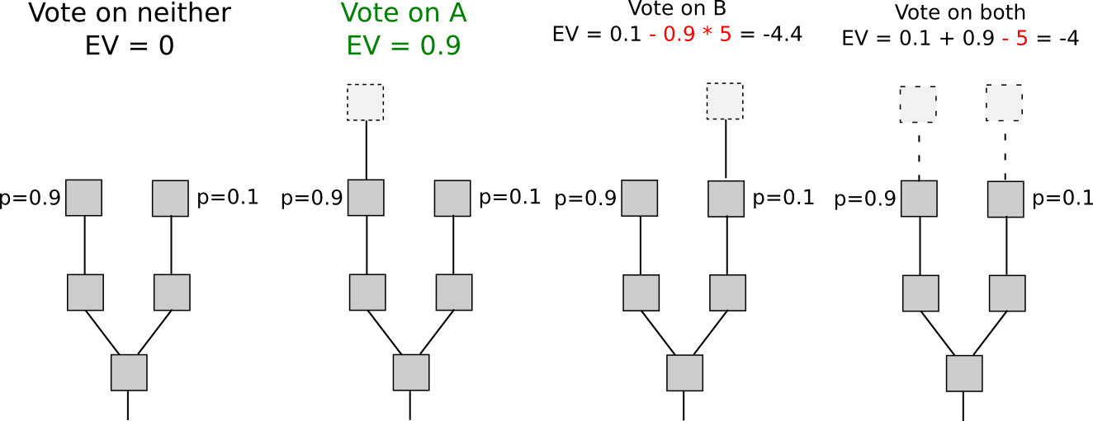
Ethereum has long held plans to adopt proof-of-stake
https://medium.com/@VitalikButerin/safety-under-dynamic-validator-sets-ef0c3bbdf9f6

Slide 77
Explore more!

Slide 78
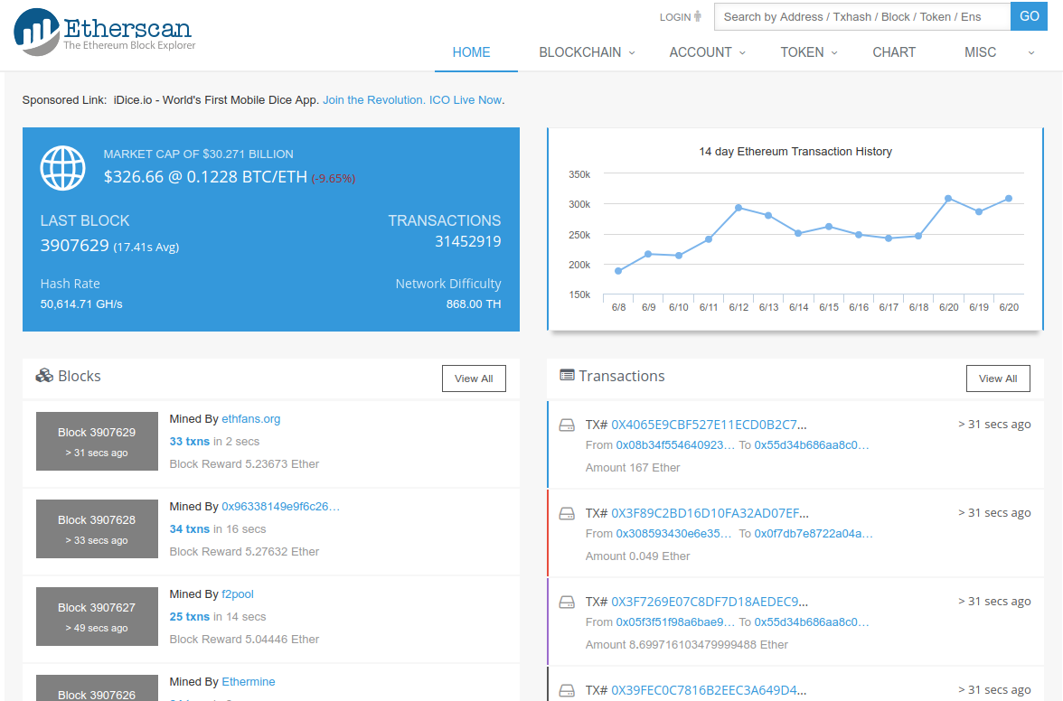
Explore the blockchain: https://etherscan.io

Slide 79
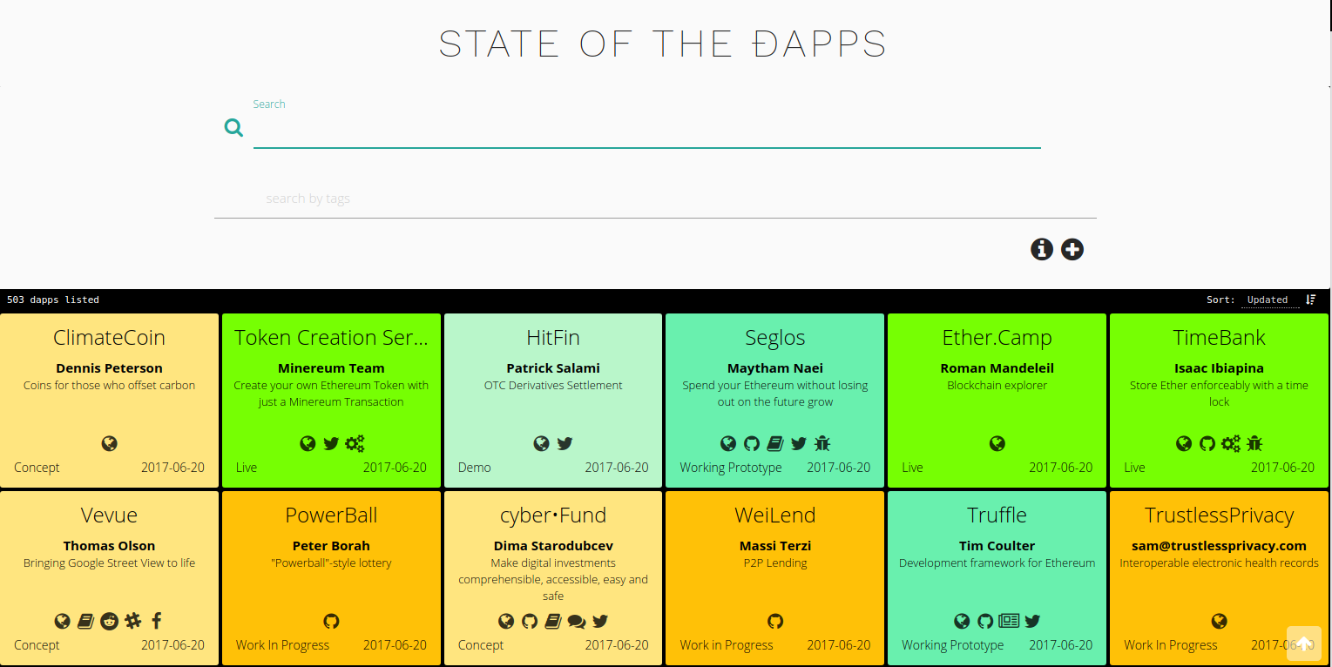
State of the Dapps: https://dapps.ethercasts.com/

Slide 80
Examples: Namecoin
mapping (bytes32 => bytes32) domainMap;
function register(bytes32 k, bytes32 v) returns(bool) {
if (domainMap[k] == 0) { // Is the key not yet taken?
// Then take it!
domainMap[k] = v;
return(true);
} else {
return(false); // Otherwise do nothing
}

Slide 81
Hard Forks in Ethereum
- Ethereum has had several hard forks
- July 20th, 2016 (to cancel “The DAO” attack)
- October 18, 2016 - November 22, 2016 Mitigate DoS attacks
Ethereum’s July 20 fork preceded a split: ETH and ETC (Ethereum Classic)
ETC is traded on exchanges, currently 1/20 size of ETH (market cap)
No evidence of “un-upgraded nodes”
ETC has also hard forked, Oct 25, 2016

